Slide 1
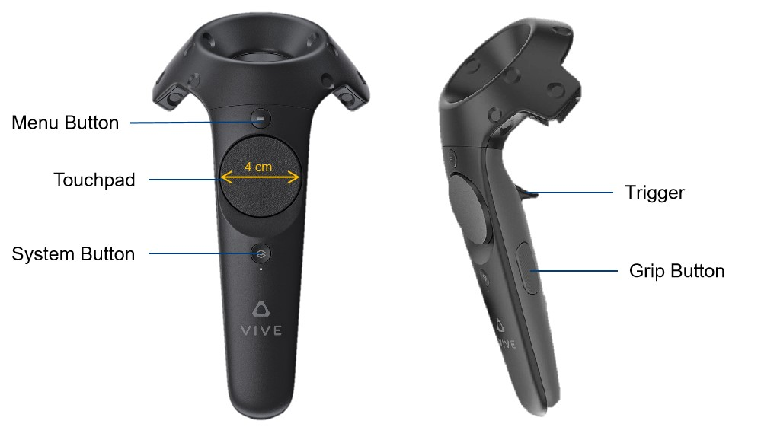
(Word Correction/
Caret Moving)
(Customize)
(Backspace)

Slide 2
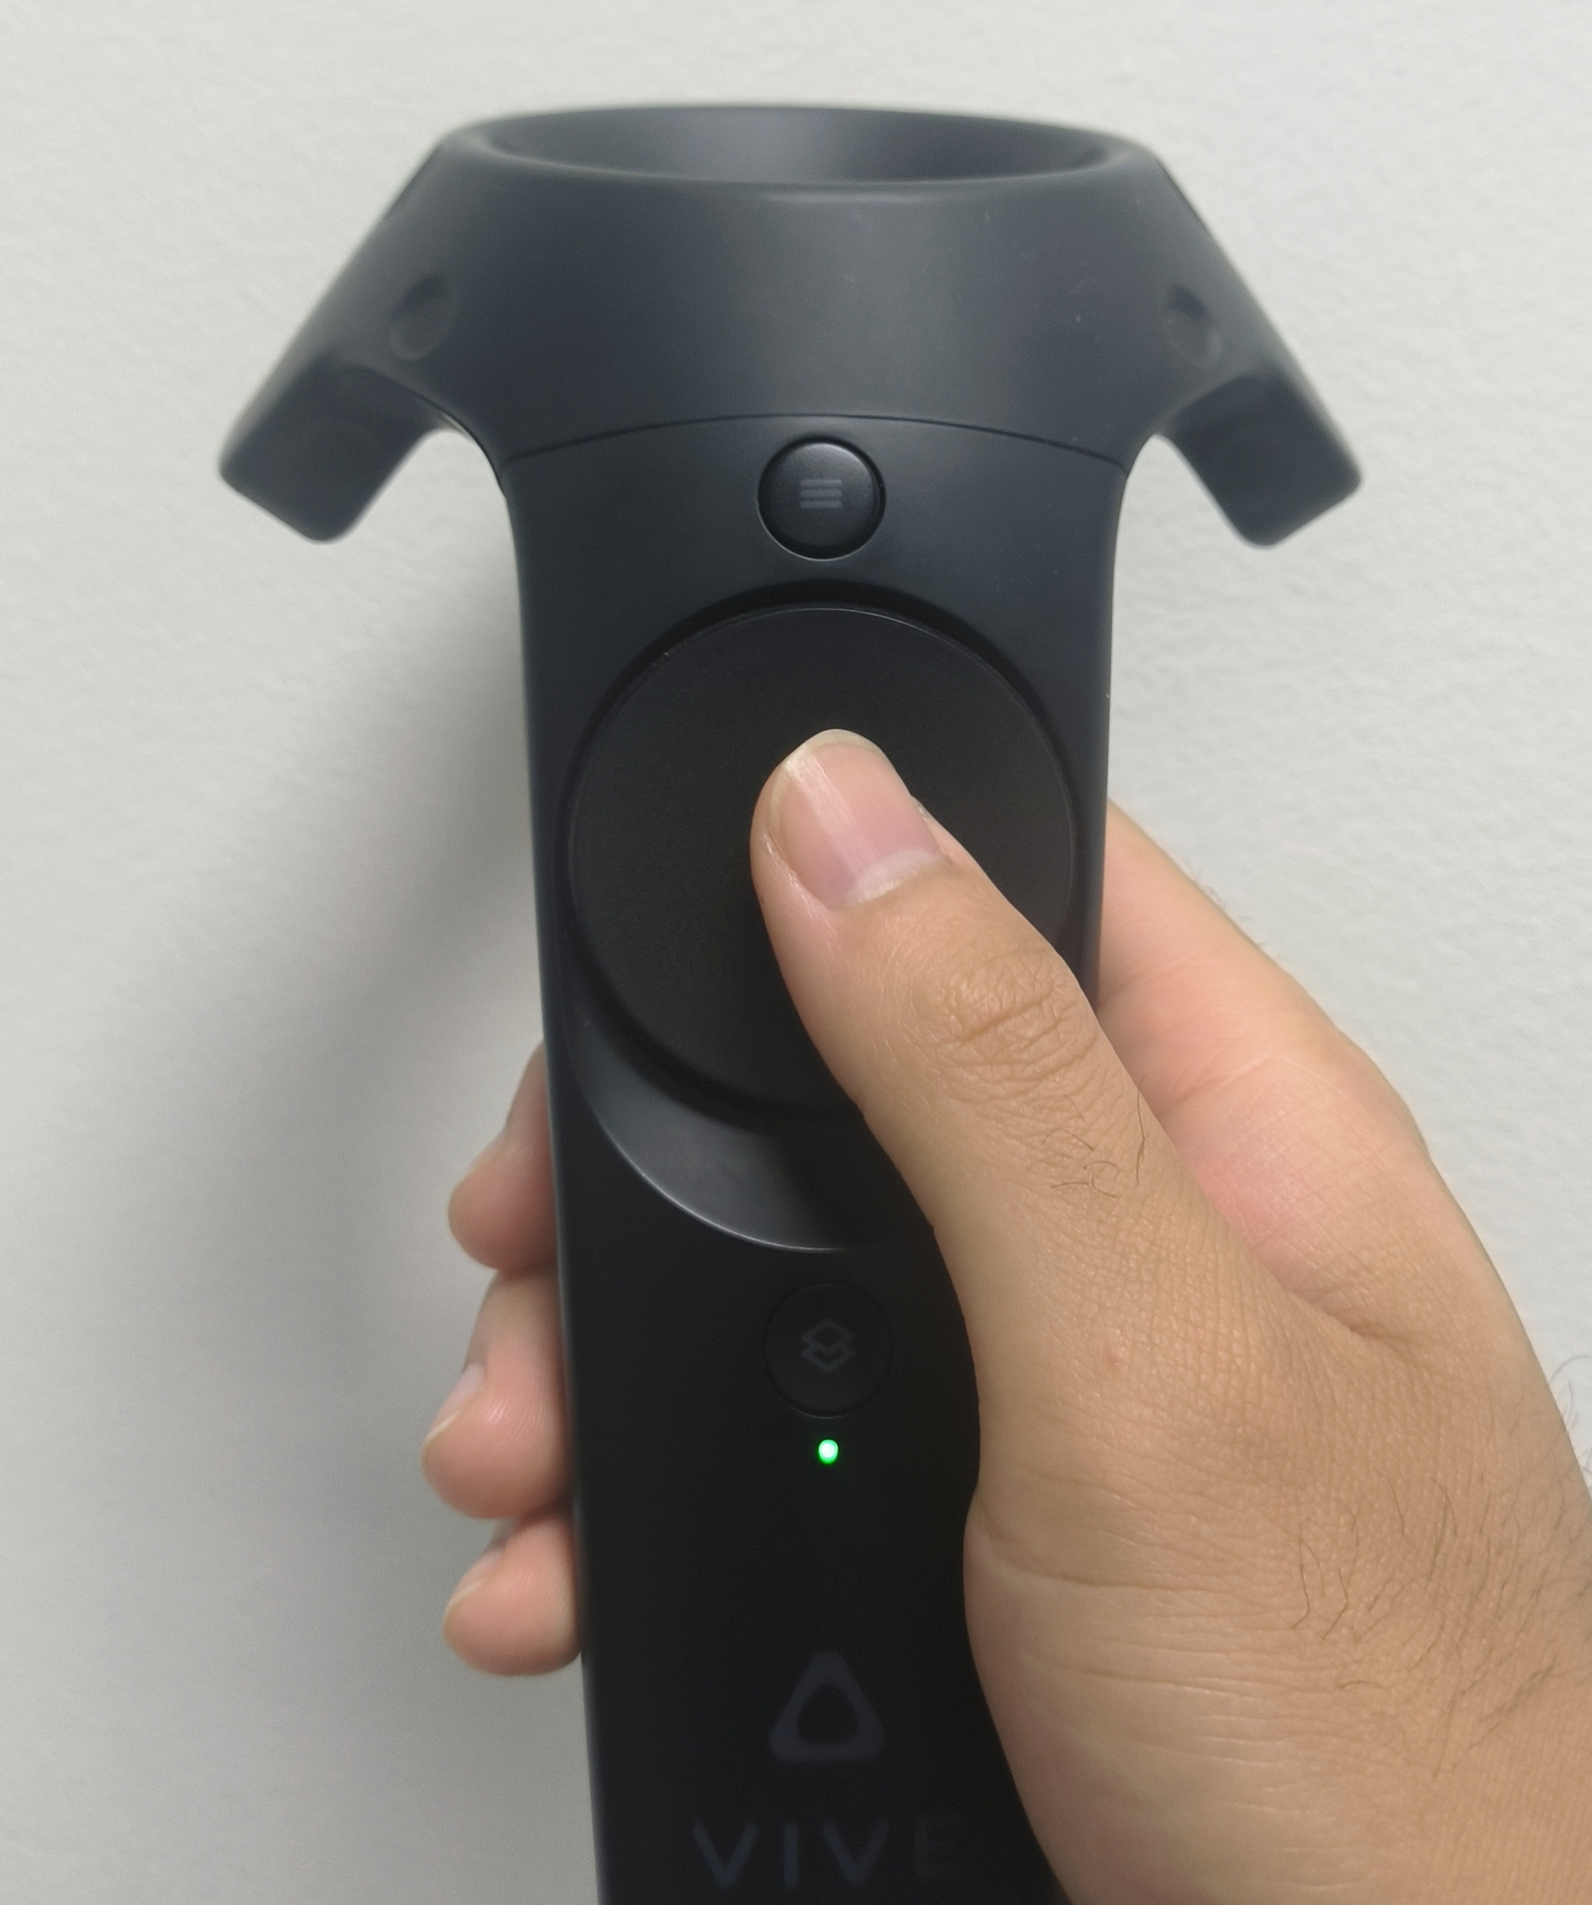

Slide 3
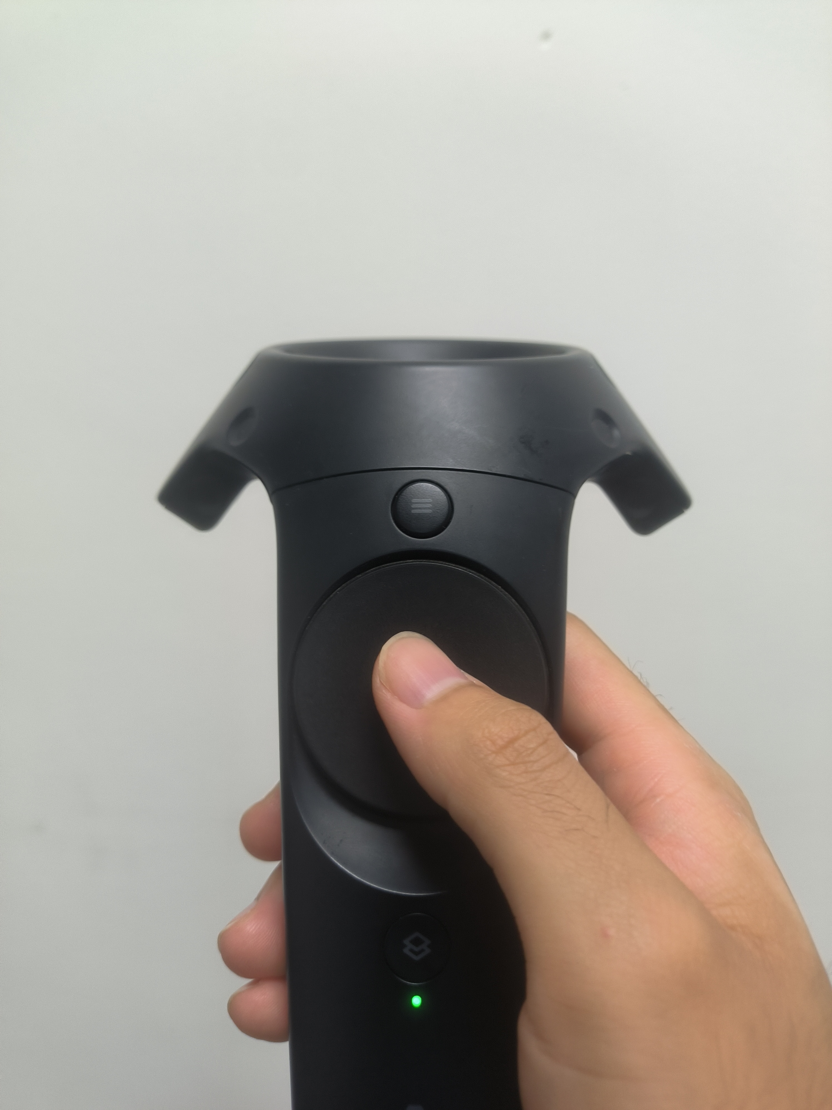
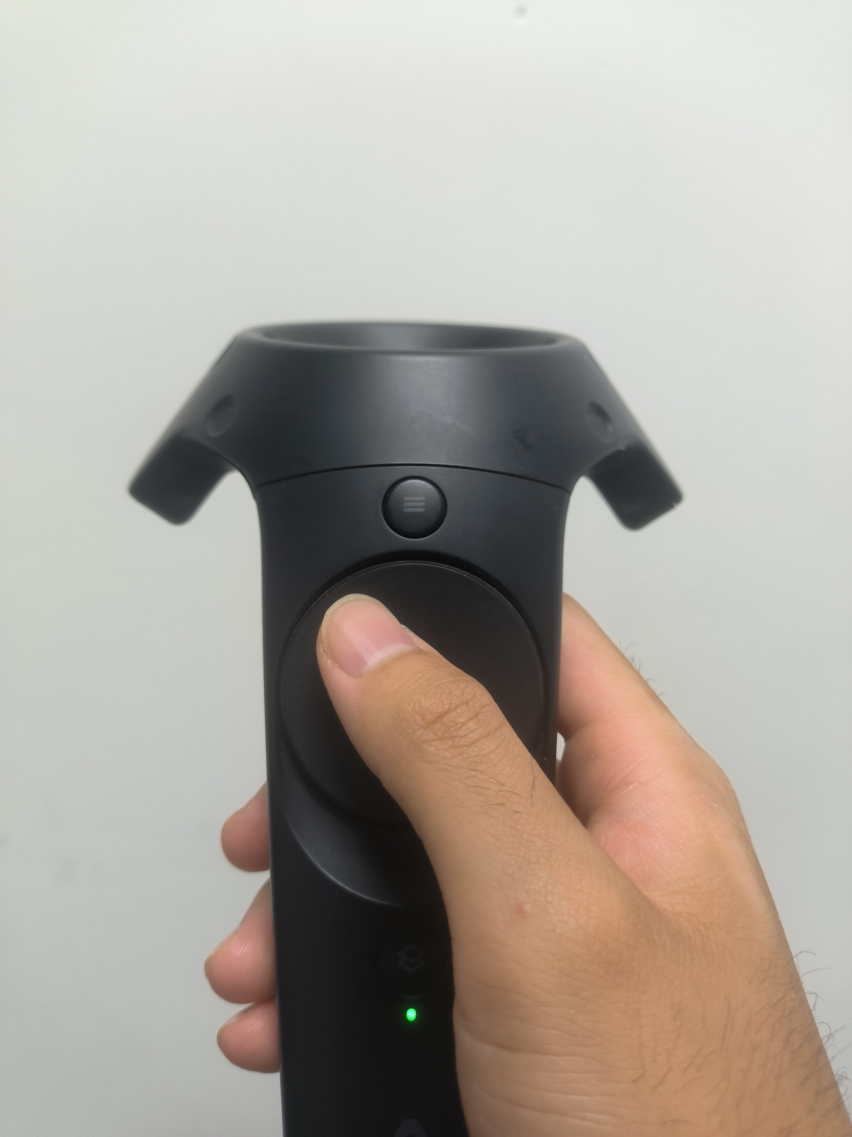

$$θ$$
r

Slide 4
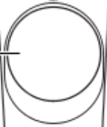


Slide 5
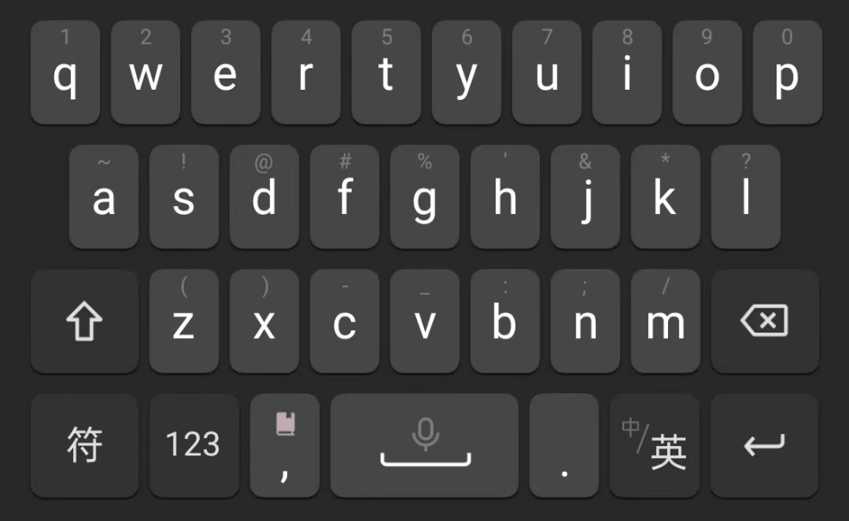

q
w
e
r
t
y
u
i
o
p
q
w
e
r
t
y
t
y
u
i
o
p
a
s
d
f
g
g
h
j
k
l
a
s
d
f
g
h
f
g
h
j
k
l
↑
z
x
c
v
v
b
n
m
back
↑
z
x
c
v
b
c
v
b
n
m
←
Sym
,
Sp
Sp
.
Enter
Sym
,
Sp
Sp
.
Enter
(a)
(b)

Slide 6
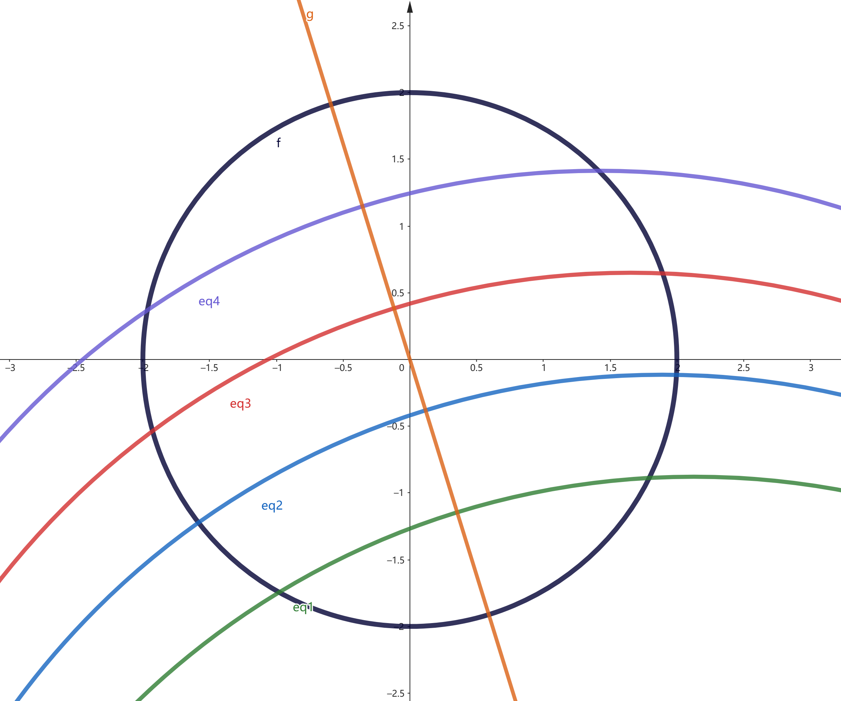
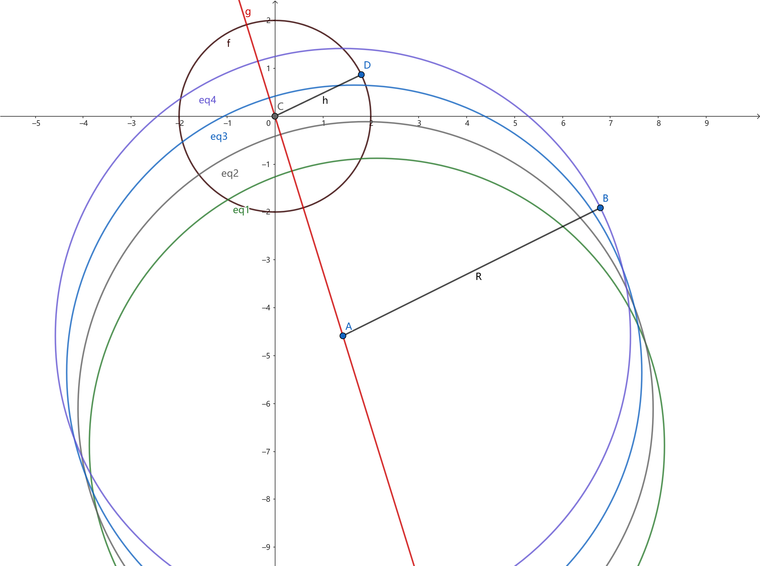
R = 2cm
R
θ
r

Slide 7
R = 2cm
θ

Slide 8

y
x
r
$$θ$$

Slide 9




l₄
arc₄
l₃
arc₃
R
l₂
arc₂
arc₁
l₁
$$θ$$
r
c₄
c₃
c₂
c₁
L

Slide 10
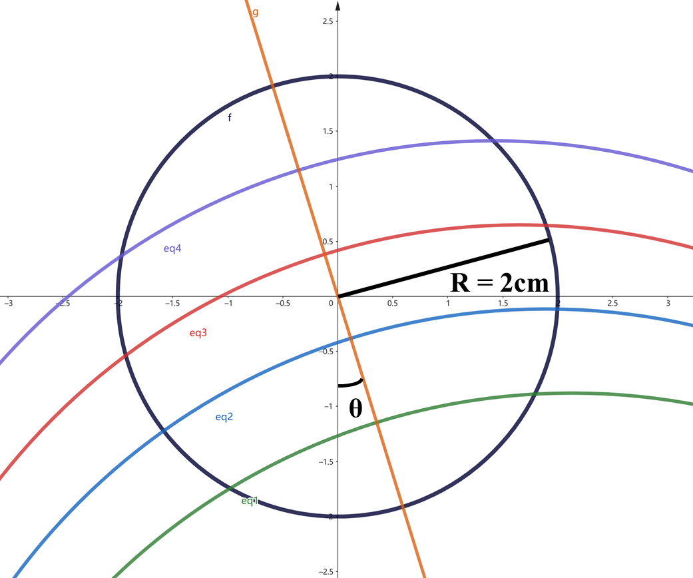

l₄
arc₄
l₃
arc₃
l₂
arc₂
arc₁
l₁
L

Slide 11

NSPad
q
w
e
r
t
y
u
i
o
p
a
s
d
f
g
g
h
j
k
l
↑
z
x
c
v
v
b
n
m
back
Sym
Sp
Sp
.
Enter
,

Slide 12
NSPad+Crossover
q
w
e
r
t
y
t
y
u
i
o
p
a
s
d
f
g
h
f
g
h
j
k
l
↑
z
x
c
v
b
c
v
b
n
m
←
Sym
Sp
Sp
.
Enter
,

Slide 13
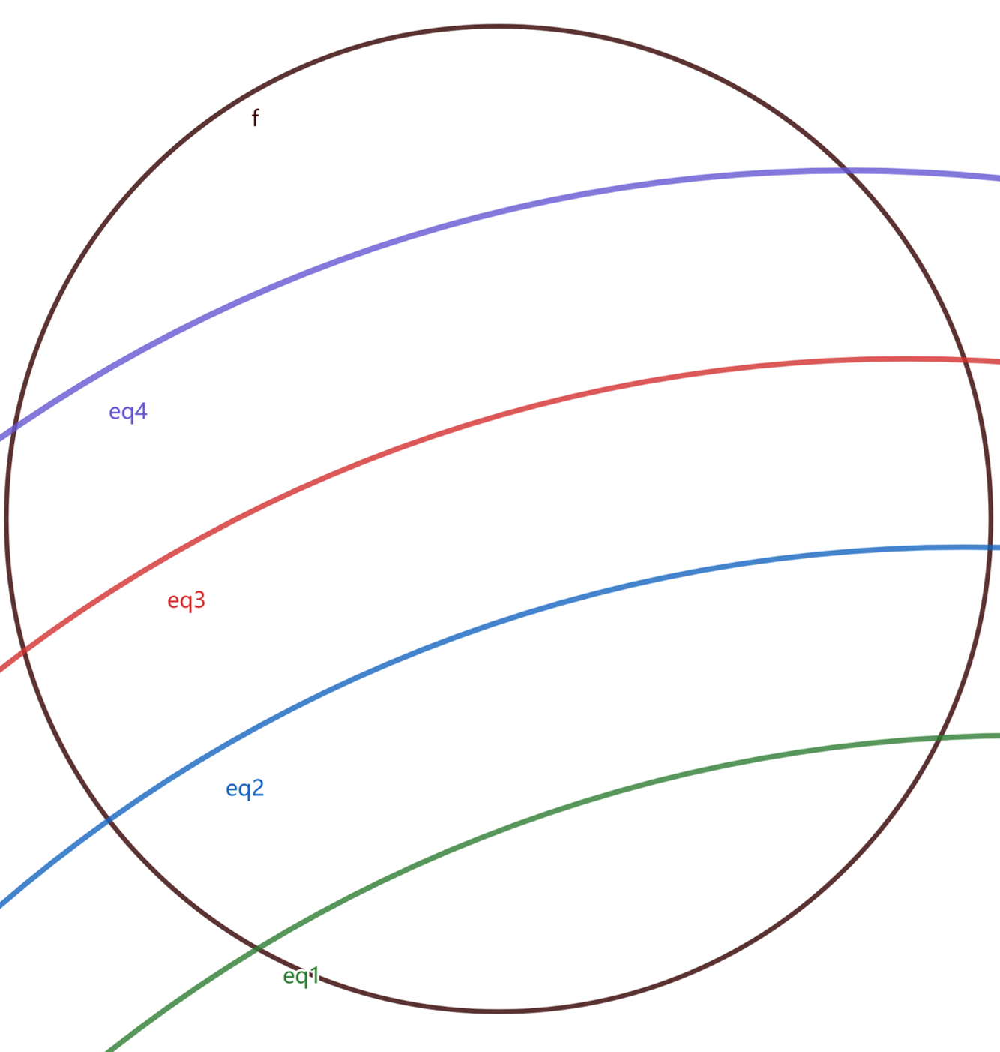
FanPad
Shift
?
!
Back
q
w
.
,
o
p
e
i
r
u
a
s
t
y
k
l
d
j
f
h
z
m
x
g
g
n
c
b
v
v
Sym
Enter
Sp
Sp

Slide 14
FanPad+Crossover
Shift
?
!
Back
q
w
.
,
o
p
e
i
r
u
t
y
a
s
k
l
d
y
t
j
f
h
z
g
g
m
x
h
f
n
c
b
v
v
b
c
Sym
Enter
Sp
Sp

Slide 18
(%)

Slide 21
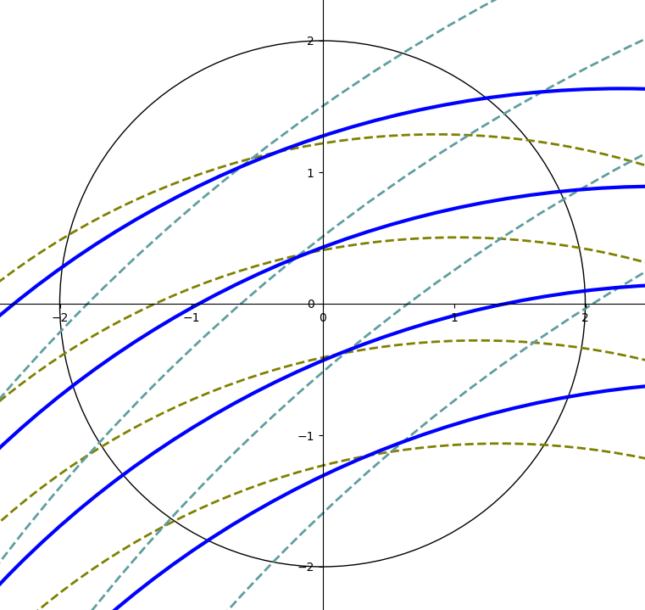






$C_{1}:θ=0.682, r=13.3$
$C_{1}$
$C_{2}:θ=0.203, r=5.5$
$C_{average}:θ=0.379, r=7.35$
$C_{average}$
$C_{2}$

Slide 22
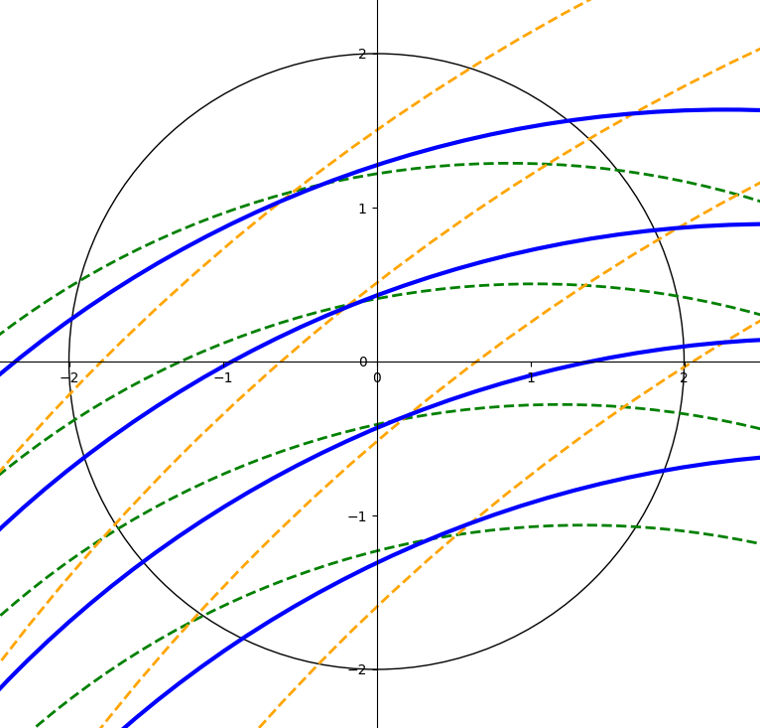
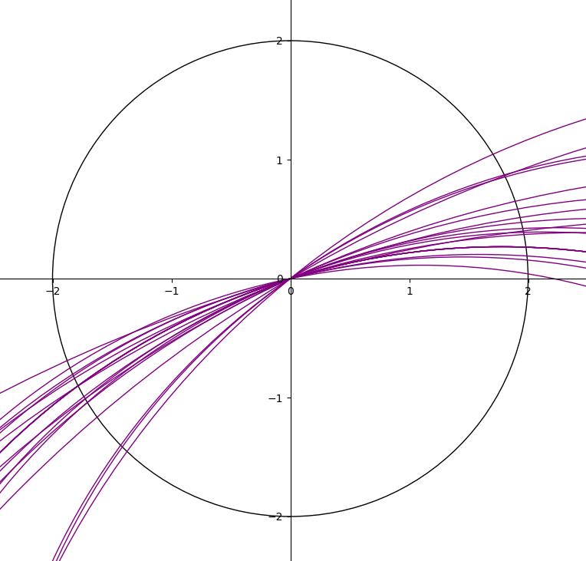





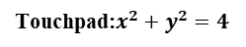

$C_{average}:θ=0.379, r=7.35$
$C_{1}$
$C_{1}:θ=0.682, r=13.3$
Touchpad:$x^{2}+y^{2}=4$
$C_{2}:θ=0.203, r=5.5$
$C_{average}$
$C_{2}$
Customized curves

Slide 23
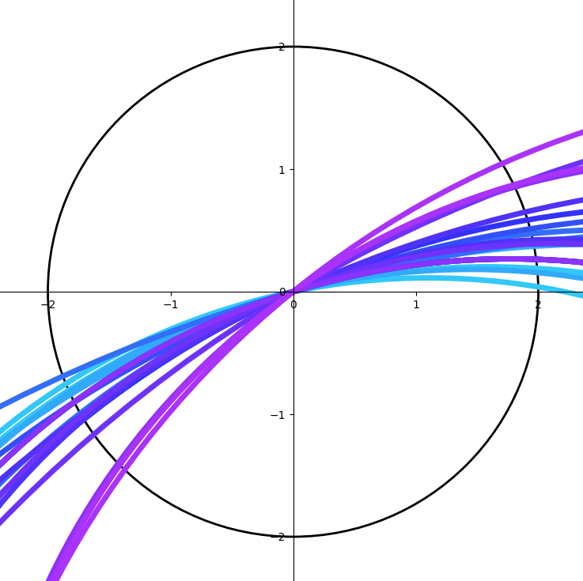
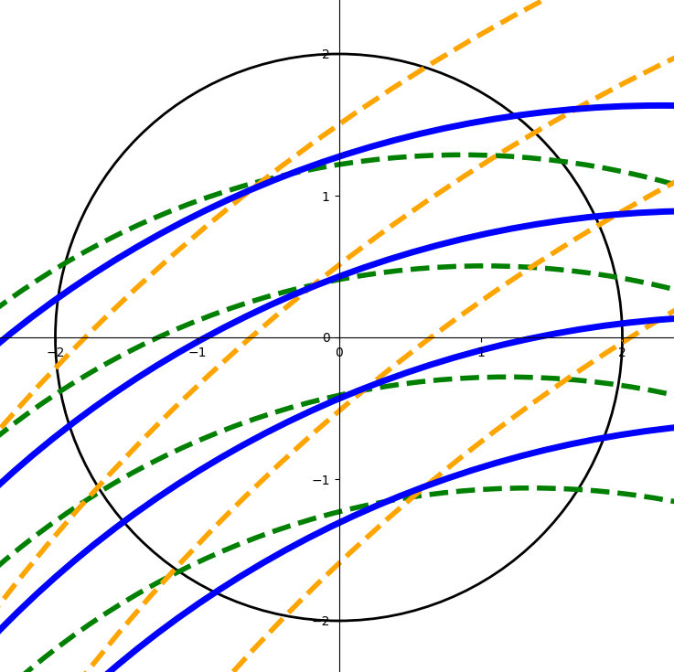
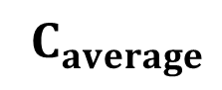



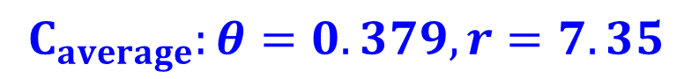
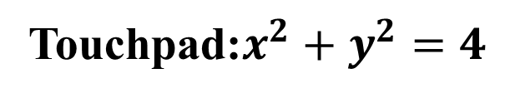

$C_{average}:θ=0.379, r=7.35$
$C_{1}:θ=0.682, r=13.3$
Touchpad:$x^{2}+y^{2}=4$
$C_{2}:θ=0.203, r=5.5$
$C_{1}$
$C_{average}$
$C_{2}$
Customized curves

